Slide 1

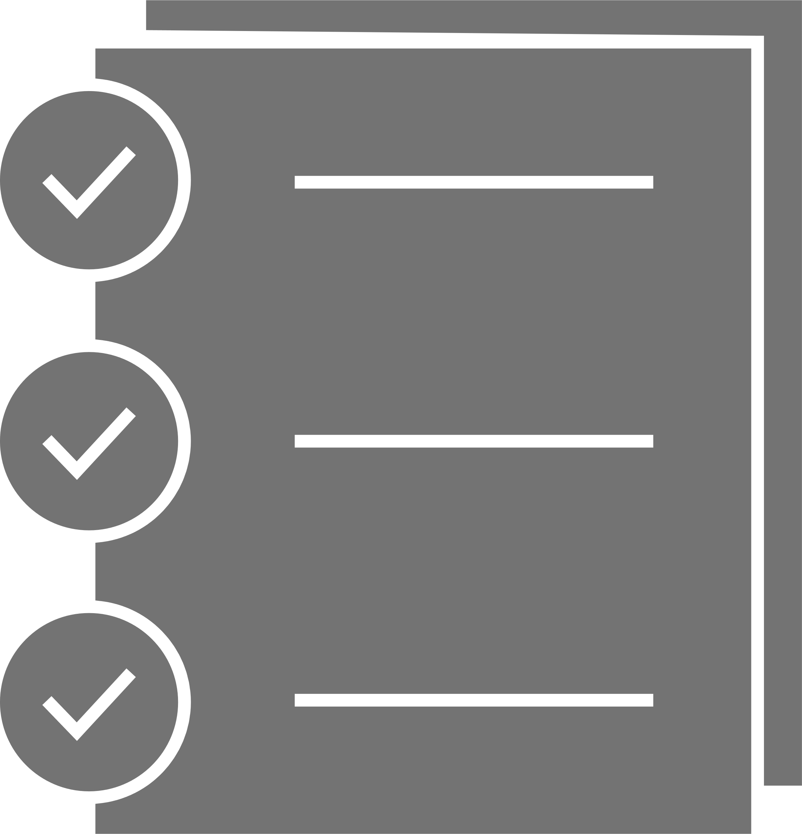

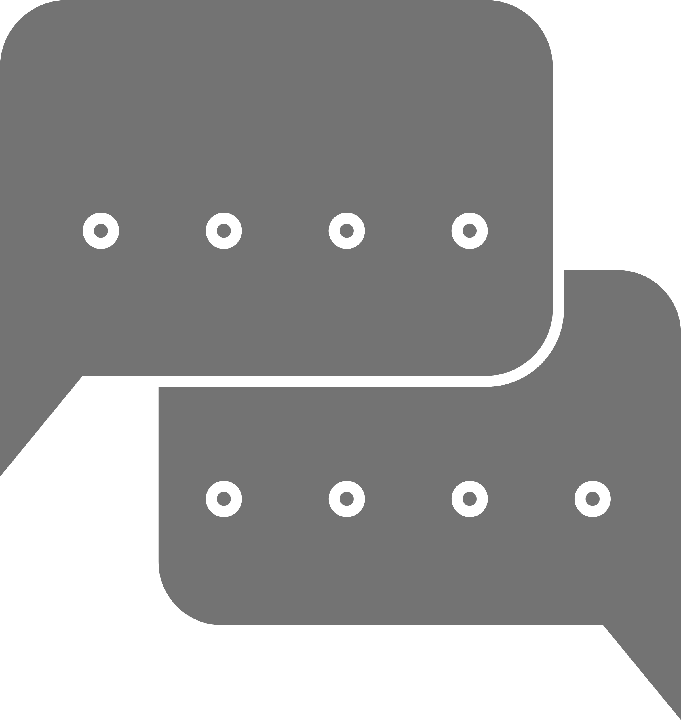



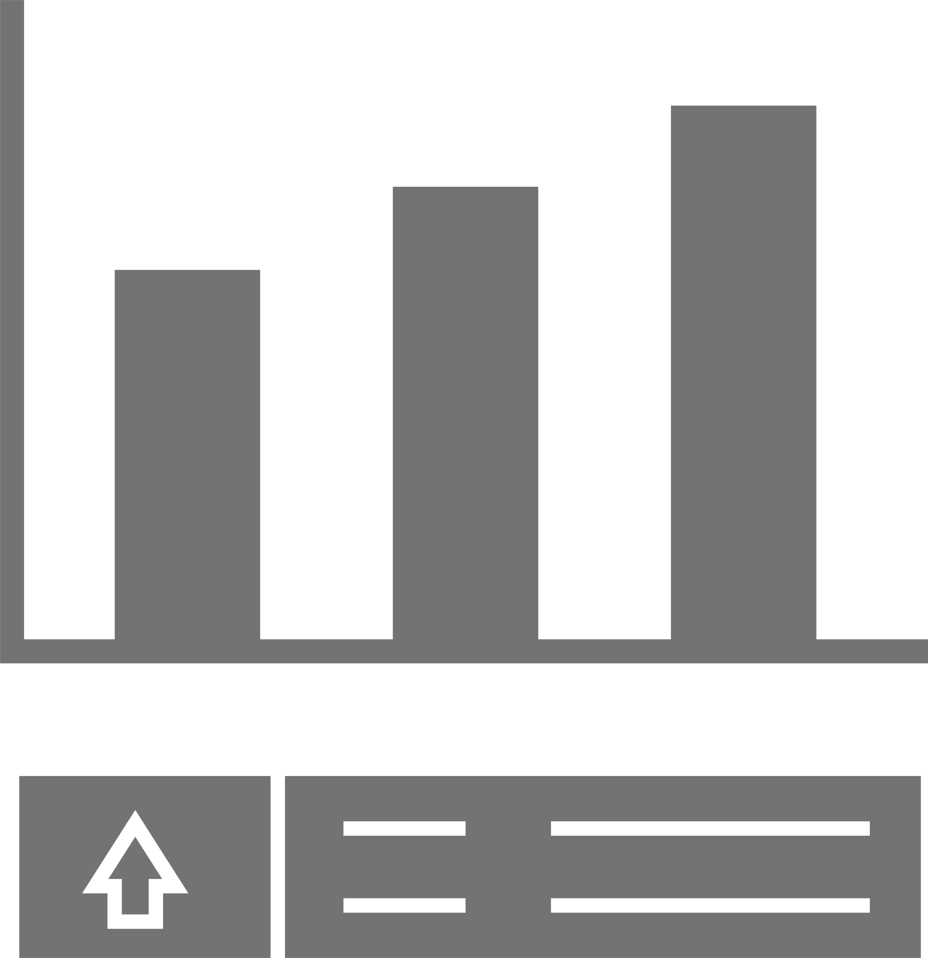
PROJECT ROADMAP
YODA
15.01.2024
Project:
Team Name:
Date
Problem Statement
Target Audience
Value Propositions
AI Approach
Technical Stack
Mute individuals encounter substantial challenges in effective communication with others, primarily stemming from difficulties in verbal expression, sensory differences, and a pervasive lack of understanding between mute and hearing individuals. To address the communication challenges, we propose the development of an innovative solution leveraging natural language processing (NLP) and computer vision technologies.
Briefly describe the chosen AI methods or models and their role in the solution
Specify the programming languages, frameworks, and tools used for development.
We are making a convenience to mute community to help them to communicate with world with great ease.
Easy to Use and User friendly UI
User Dictionary (optional)
Responsive
Future use for multi-lingual sign language formats
Mute community
Industries who have mute people in their workspace
Industries who make solutions for disabled people
Natural Language Processing (NLP): Preprocess and analyze standard sign language
Machine Learning: Train the model to understand meaning and patterns of signs
Programming languages: Python
Libraries: OpenCV
Machine learning frameworks: TensorFlow, scikit-learn
Cloud platform: Google Firebase (BaaS)
Data and Resources
To create this sign language-to-text application in Flutter a crucial component is a well-annotated dataset containing a variety of sign language gestures. I also need a reliable source of real-time video data, either from a camera feed or prerecorded videos, to implement the OpenCV functionality for capturing and processing sign language gestures effectively. The integration of OpenCV in this Flutter project involves handling tasks such as hand detection and tracking.
Team
Success Criteria
Anushka Girish - Flutter Frontend/ Backend Integration
Avin Mantri - Backend Integration
Suhanee Hingorani - AI Integration(Sign Language)/ Flutter Frontend
Sanika Kotgire - Backend Integration
Swara Kubade - Flutter Front-End
Vedant Kumbhar – AI(Sign Language)
Define what constitutes a successful outcome for your project.
The application must accurately recognize and interpret a wide range of sign language gestures. High precision in recognizing different signs contributes to effective communication.
The application should operate in real-time, ensuring minimal latency in capturing, processing, and translating sign language gestures. Quick responsiveness is crucial for seamless communication.

